Slide 1



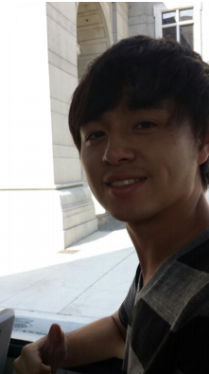
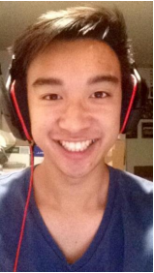

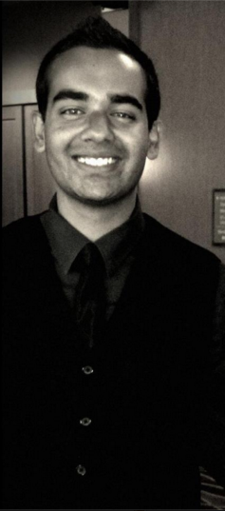
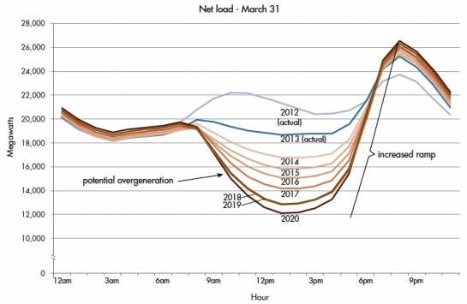
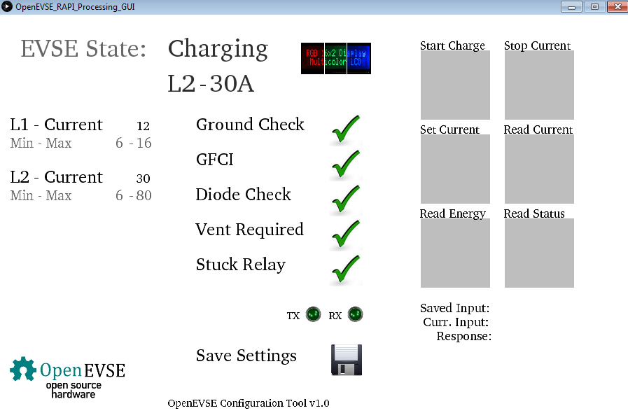
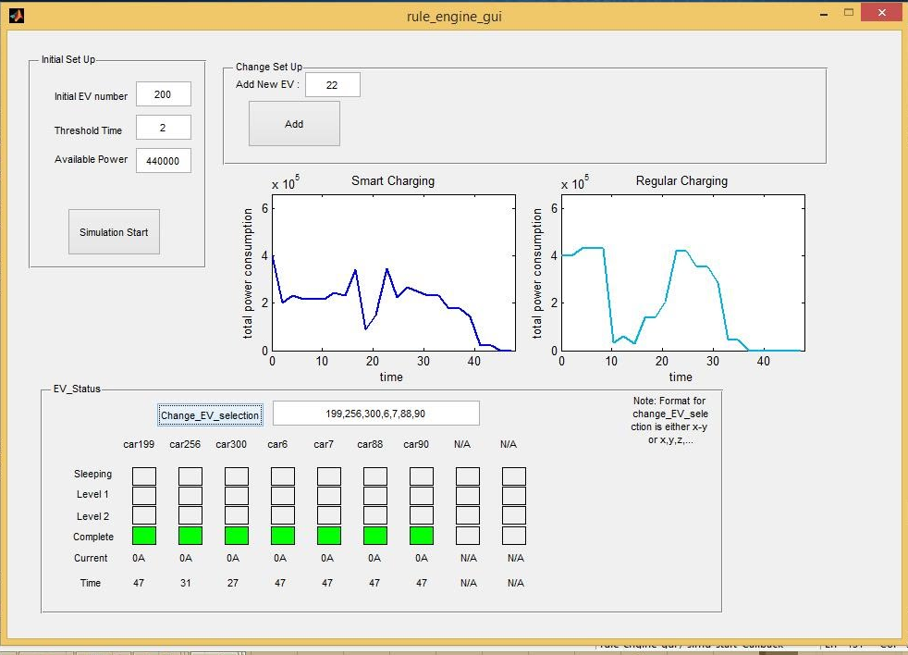
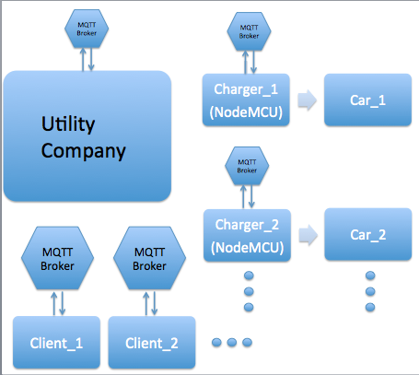

Smart Devices and Electric Vehicle Chargers for Grid Demand Response Team HAM: Ming Wang, Anthony Vu, Hongnian Yu, Arunav Singh Advisors: Professor G.P. Li and Dr. Michael Klopfer Department of Electrical Engineering and Computer Science
Problem Identification & Motivation
Subsystem Design
Current System Design
Team Members & Roles
A change in electrical generation and loading patterns in California has lead to a phenomenon known as the “Duck Curve.” High generation during the day from solar is reduced as the sun sets and people begin their afternoon and evening activities. Domestic loads, (appliances, residential plug loads, HVAC, lighting, etc.) now combined with the relatively new, wide adoption of EVs, have lead to increased evening power grid loads. Could utilities actively work with EV owners to meet all charging needs without putting an increased strain on the power grid?
The current rules engine is implemented via MATLAB. This contains the algorithms for the smart charging schedule and can simulate different weather patterns across four different seasons for a system containing any number of vehicles. This is the control seen by the utility companies.
The RAPI protocol was implemented via Processing. This, when combined with MQTT allows the user to control the OpenEVSE itself. All the essential functions such as Start Charging, Read Energy, Read Status, etc. are available for the user.
There are two major systems within the current design layout. The first major interface is found in the garage. There, a box can be found with two external connectors and one internal communication device. One external connector is connected to utility power. The other external connector is the J1772 standard car connector. Our system employs the use of MQTT for communication between the client and the charger itself. We use CloudMQTT as our MQTT broker.
Ming Wang (EE): Team lead. Hardware design and
software development.
Anthony Vu (CpE): Software and firmware design and implementation lead.
Hongnian Yu (EE): Circuit design, embedded firmware and software development.
Arunav Singh (EE): Hardware and software design implementation.
Michael Klopfer (BME): Introduced the initial ideas and provides assistance throughout the project.
Summary & Business Opportunity
The target market includes major utility companies as well as plug-in car owners. This product is seeing an increasing market every year as the shift towards renewable energy and electric vehicles is growing. This product would be most popular in California, which is home to more EVs than any other state; roughly 100k with an additional 70k plug-ins vehicles. In fact, this number is bound to soar with 1 million EVs projected to be on road nationwide by 2020. We believe that this product has the potential to make a serious impact on a growing problem.
Data Simulation
Acknowledgement
Plan & Contact
Innovation & Solution
Design Method
The authors would like to acknowledge the support provided from Christopher Howell of the OpenEVSE project.
Special thanks to Calplug for the funding and facilities to bring this project to life and supporting its development
In order to demonstrate the implementation of our system we came up with the following to simulate power availability. We focused on three major sources of renewable energy: Wind, Solar PV, and Solar Thermal. To represent the different weather patterns across the year we collected data from January, April, July, and October to represent each season in the year. We are able to simulate changes in available power due to sudden increases in wind speed (gusts, storms, etc.). This allows us to create a comprehensive simulation to demonstrate the impact of our system.
Full integration into the current infrastructure is required in order to test this system on a bigger scale.
Anyone who is seeking to learn more about this project can visit openevse.com for details about the charger.
Contact the team captain, Ming Wang, at mingw3@uci.edu or our mentor, Dr. Michael Klopfer, at mklopfer@uci.edu for any additional information.
We plan to solve the “Duck Curve” problem with the system we have designed. This will allow utilities to dynamically start, stop and throttle charging rate for a number of EV users simultaneously, depending on grid conditions and user charging behaviors. Also, predictive algorithms predict evening charge requirements from user behavioral charge history, grid infrastructure conditions, and weather forecasts. Therefore, this system will be beneficial for both users and utilities alike.
Notes:
‹#›

